Slide 1


Computer Networks (CY245AT) - UNIT-I
By
Prof. Narasimha Swamy S
Department of AIML
R V College of Engineering®, Bengaluru-59

Slide 2
Outline
Introduction
Perspective
Business Domains
Resource Sharing
Client Server Programming
e-commerce and Digital communications
Network and Network Types
Network Models
TCP / IP protocol suite
Addressing
The OSI Model
Transmission Modes
Parallel Transmission
Serial Transmission
Link Layer
Data Link Control (DLC)
DLC Services
Data Link Layer Protocols
High Level Data Link Control (HDLC)
Point-to-Point Protocol (PPP)
Framing
Transition Phases
Media Access Control (MAC)
Random Access
CSMA/CD
CSMA/CA

Slide 3
Definition
A Computer Network (CN) is a system that connects two or more computing devices for transmitting and sharing information
(or)
Networking refers to interconnected computing devices that can exchange data and share resources with each other

Slide 4
Perspectives
Users: List the set of requirements will be given
A Network Designer: would list the properties of a cost-effective design—for example, that network resources are efficiently utilized and fairly allocated to different users. Issues of performance are also likely to be important.
A Network Operator: would list the characteristics of a system that is easy to administer and manage—for example, in which faults can be easily isolated, new devices can be added to the network and configured correctly, and it is easy to account for usage.
An Application Programmer: would list the services that his or her application needs—for example, a guarantee that each message the application sends will be delivered without error within a certain amount of time or the ability to switch gracefully among different connections to the network as the user moves around.

Slide 5
Applications
Resource Sharing
A network is designed to support a potentially large number of users that exchange information with each other. These users produce and consume information which is exchanged through the network
To support its users, a network uses several types of resources: Hardware, Software, and Network Resources
Hardware Recourse Sharing
Hardware resource sharing refers to the practice of allowing multiple users or processes to utilize the same physical hardware components efficiently (Cloud Computing, Fog Computing, edge Computing)
Software Resource Sharing
Software resource sharing involves the efficient allocation and utilization of software resources such as applications, libraries, services, and licenses across multiple users, processes, or systems.
Network Resource Sharing
Network resource sharing involves the efficient utilization and distribution of networking resources such as bandwidth, connectivity, and devices across multiple users, applications, or systems

Slide 6
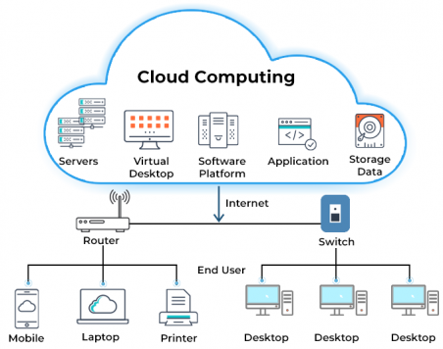
Applications
Resource Sharing

Slide 7
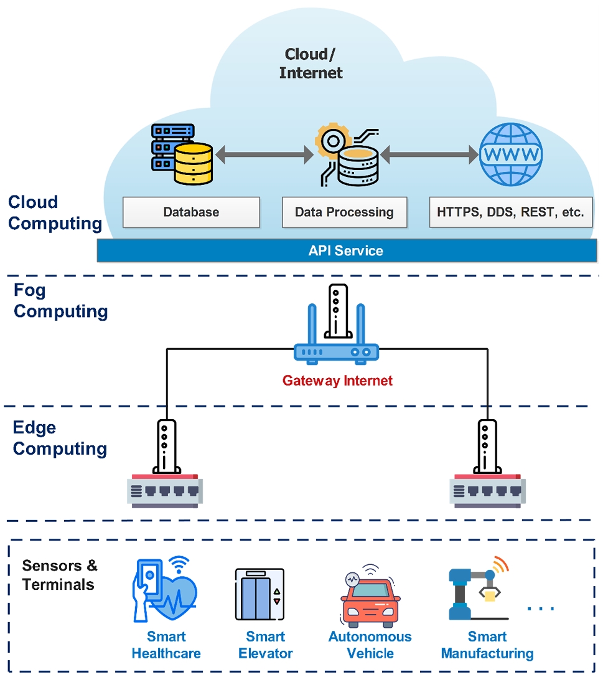
Applications
Resource Sharing – Computing Hierarchy

Slide 8
Applications (Contd.)
Client-Server Programming
A Client-server programming is a paradigm used in networked applications where client devices request services or resources from server devices.
A client is a device or application that initiates communication with a server to request services or resources. Clients can be desktop computers, laptops, mobile devices, or software applications.
A server is a device or application that provides services or resources to clients in response to their requests. Servers can be dedicated hardware machines or software processes running on a computer. In client-server programming, servers listen for incoming requests from clients, process them, and send back responses
Communication Protocols: Client-Server communication relies on protocols that define rules and formats for exchanging data between clients and servers. Common protocols used in client-server programming include HTTP (Hypertext Transfer Protocol) for web-based applications, TCP/IP (Transmission Control Protocol/Internet Protocol) for general-purpose networking, and WebSocket for real-time communication.

Slide 9
Applications
Client-Server Programming
A Client-server programming can be implemented using the Application Programming Interfaces (APIs)
Operating System (OS) provides set of interface to its networking subsystem. This interface is often called the network application programming interface (API).
Every operating system is free to define its own network, over the time certain of these APIs have become widely supported; that is, they have been ported to operating systems other than their native system.
Berkeley distribution of Unix, which is now supported in virtually all popular operating systems.
Each protocol provides a certain set of services, and the API provides a syntax by which those services can be invoked on a particular computer system.
The main abstraction of the socket interface, is the socket

Slide 10

Applications (Contd.)
Client-Server Programming
Socket
Sockets are the endpoints of a bidirectional communications channel
Sockets may communicate within a process, between processes on the same machine, or between processes on different continents.
SEND
RECIEVE
Endpoint-1
Endpoint-2
Communication Channel
Coaxial Cables, Fibre Optics, Air, and many more

Slide 11
Applications (Contd.)
Client-Server Programming
Network APIs
To create a socket
int socket(int domain, int type, int protocol)
The next step depends on whether you are a client or a server.
On a server machine, the application process performs a passive open—the server says that it is prepared to accept connections, but it does not actually establish a connection.
The server does this by invoking the following three operations:
int bind(int socket, struct sockaddr *address, int addr_len)
int listen(int socket, int backlog)
int accept(int socket, struct sockaddr *address, int *addr_len)
The bind operation, as its name suggests, binds the newly created socket to the specified address.
The listen operation then defines how many connections can be pending on the specified socket.

Slide 12
Applications (Contd.)
Client-Server Programming
Network APIs
On the client machine, the application process performs an active open; that is, it says who it wants to communicate with by invoking the following single operation:
int connect(int socket, struct sockaddr *address, int addr len)
Once a connection is established, the application processes invoke the following two operations to send and receive data:
int send(int socket, char *message, int msg len, int flags)
int recv(int socket, char *buffer, int buf len, int flags)

Slide 13
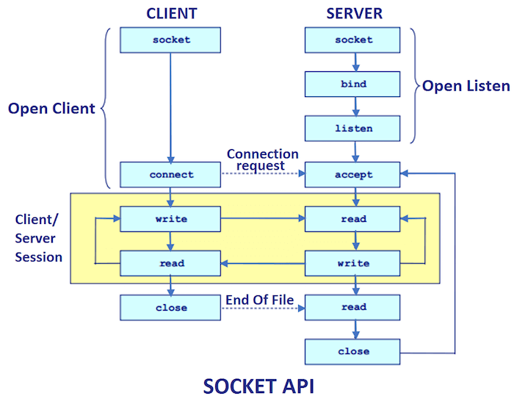
Applications (Contd.)
Client-Server Programming

Slide 14
Applications (Contd.)
Client-Server Programming – Server Example
import socket
def server_program():
host = socket.gethostname()
port = 5000
server_socket = socket.socket()
server_socket.bind((host, port))
server_socket.listen(5)
conn, address = server_socket.accept()
print("Connection from: " + str(address))
while True:
data = conn.recv(1024).decode()
if not data:
break
print("from connected user: " + str(data))
data = input(' -> ')
conn.send(data.encode())
conn.close() # close the connection
server_program()

Slide 15
Applications (Contd.)
Client-Server Programming – Client Example
import socket
def client_program():
host = socket.gethostname()
port = 5000
client_socket = socket.socket()
client_socket.connect((host, port))
message = input(" -> ")
while message.lower().strip() != 'bye’:
client_socket.send(message.encode())
data = client_socket.recv(1024).decode()
print('Received from server: ' + data)
message = input(" -> ")
client_socket.close()
client_program()

Slide 16
Applications (Contd.)
Client-Server Programming – Port Number
A port number is a 16-bit unsigned integer (ranging from 0 to 65535) assigned to a specific network service or application. It is part of the addressing information in the header of a TCP or UDP packet.
Generally, port numbers are used to distinguish between different services or applications running on the host
Types of Ports
Well-known Ports (0-1023): Reserved for commonly used services, such as HTTP (port 80), FTP (port 21), SSH (port 22), and SMTP (port 25). These ports are standardized by the Internet Assigned Numbers Authority (IANA).
Registered Ports (1024-49151): Assigned to user or vendor-specific services upon request. They are not standardized but can be registered with IANA to avoid conflicts.
Dynamic or Private Ports (49152-65535): Also known as temporary ports, they are used as temporary ports by client applications when initiating communication with a server. These ports are randomly assigned by the operating system.

Slide 17
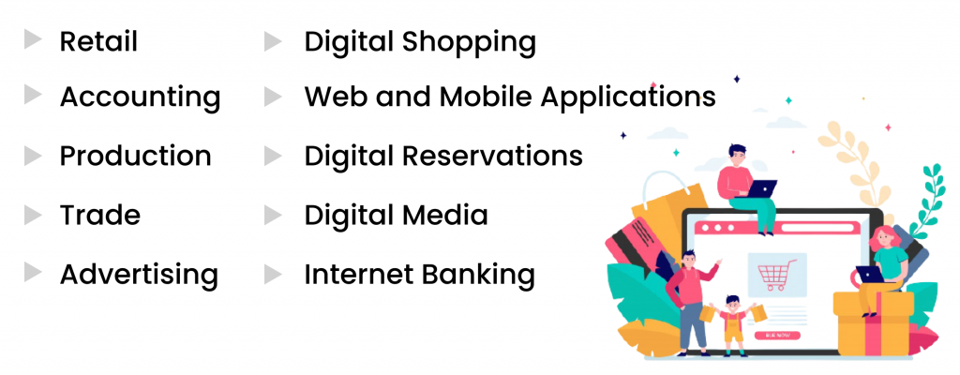
Applications (Contd.)
E-Commerce Application/ Platform
An e-commerce Application/ Platform is a software that enables the commercial process of buying and selling over the internet

Slide 18
Applications (Contd.)
E-Commerce Application
E-commerce applications heavily rely on computer networks for several key benefits
Global Reach: Computer networks enable e-commerce platforms to reach customers world-wide.
4/7 Availability: With computer networks, e-commerce platforms can operate round the clock, allowing customers to shop at any time convenient to them. This continuous availability enhances customer satisfaction and increases sales potential
Personalized Marketing: E-commerce platforms leverage computer networks to gather and analyze customer data. They use this information to personalize marketing campaigns, recommend products based on past purchases, and tailor promotional offers to individual preferences, thereby increasing sales conversion rates.
Inventory Management: Computer networks facilitate real-time synchronization of inventory across multiple warehouses, stores, and distribution centers. This ensures accurate stock levels, minimizes overstocking or stockouts, and improves overall supply chain efficiency.

Slide 19
Applications (Contd.)
E-Commerce Application
Customer Service: Networks enable e-commerce platforms to offer various customer service channels, including live chat, email support, and social media interactions. This enhances customer satisfaction by providing prompt assistance and resolving queries in a timely manner.
In essence, computer networks form the backbone of e-commerce applications, enabling them to offer a seamless, secure, and scalable shopping experience to customers while facilitating efficient operations and business growth.

Slide 20
Introduction
Communication
Communication is nothing but sharing of information (or) Data communication is basically exchange of data between devices
When communication is local, it happens face to face
The main components of data communication include:
Data- The information that is to be shared. For example: text, audio, video and images.
Sender and Receiver- The device that is capable of sending and receiving of messages. It could be a computer, workstation, mobile devices etc.
Protocol- It is the set of rules that govern the data communications. It is basically an agreement between two communicating devices. In absence of a protocol, the devices are connected but they will not be able to communicate with each other.
Transmission Medium- The path by which the data is exchanged between the devices.

Slide 21
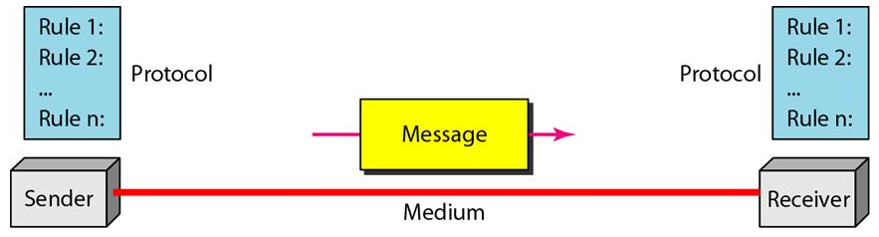
Introduction (Contd.)
Figure. Components of Data Communication

Slide 22
Introduction (Contd.)
Networks and It’s Type
Definition: Networks is interconnection of devices that are able to communicate/ interact with other devices
The device could be an end node or a connecting device
The example for the former is a computer system, mobile device, laptop, desktop, security system etc. and example for latter is a switch, router, gateways etc.
The devices in the network are connected using a wired or wireless connections
Network Criteria
A network must be able to meet a certain number of criteria such as Performance, Reliability and Security
Performance
Performance can be measured in transit time and response time
Transit time is the amount of time required for a message to travel from one device to another and Response time is the elapsed time between an inquiry and a response

Slide 23
Introduction (Contd.)
The performance of a network depends on a number of factors, including the number of users, the type of transmission medium, the capabilities of the connected hardware, and efficiency of the software
Performance is often evaluated by two networking metrics: throughput and delay
We often need high throughput and less delay
However, these two criteria are often contradictory. If we try to send more data to the network, we may increase throughput but we increase the delay because of traffic congestion in the network.
Reliability
It is measured by the frequency of failure, the time it takes a link to recover from a failure, and the network’s robustness in a catastrophe
Security
It includes protecting data from unauthorized access, protecting data from damage and development, and implementing policies and procedures for recovery from breaches and data losses

Slide 24
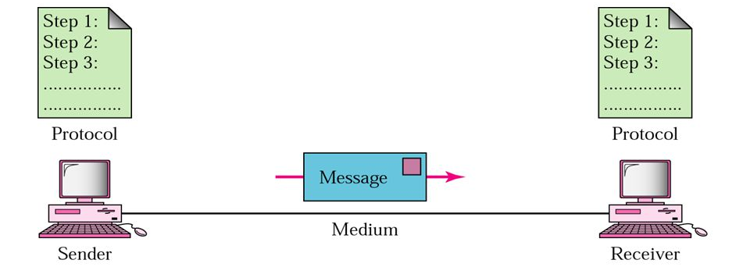
Introduction (Contd.)
Physical Structures
Network is formed by connecting various devices., these devices can be connected using
Point-to-Point Connection
Multi-point Connection
Point to Point Connection
Provides a dedicated link between two devices
The entire capacity of the link is reserved for transmission between those two devices
Most point-to-point connections use an actual length of wire or cable to connect the two ends, but other options, such as microwave or satellite links, are also possible
Figure. Point to Point Communication

Slide 25
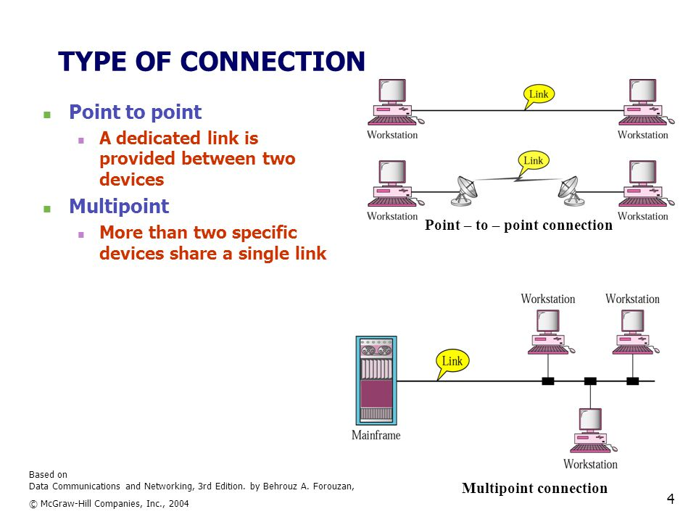
Introduction (Contd.)
Multipoint Connection
A multipoint (also called multidrop) connection is one in which more than two specific devices share a single link
Figure. Multi-point Communication

Slide 26
Introduction (Contd.)
Network Topologies
The term physical topology refers to the way in which a network is laid out physically. Two or more devices connect to a link; two or more links form a topology
The topology of a network is the geometric representation of the relationship of all the links and linking devices (usually called nodes) to one another.
There are four basic topologies possible
Mesh
Star
Bus, and
Ring

Slide 27
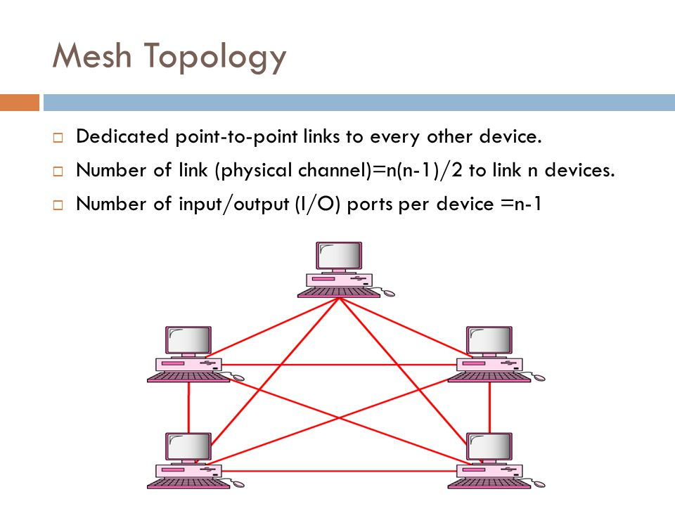
Introduction (Contd.)
Mesh Topology
In a mesh topology, every device has a dedicated point-to-point link to every other device
Properties
A dedicated link carries data between two devices only, thus provides high reliability.
A mesh topology is robust-If one link becomes unusable, it does not incapacitate the entire system
Provides privacy and data security- When every message travels along a dedicated line, only the intended recipient sees it.
Point-to-point links make fault identification and fault isolation easy.
Requires more amount of cabling and I/O ports.
Hence laying down the network in mesh topology is expensive.
Figure. Mesh Topology
Applications
Used in backbone networks, for example- connection of telephone regional offices in which each regional office needs to be connected to every other regional office

Slide 28
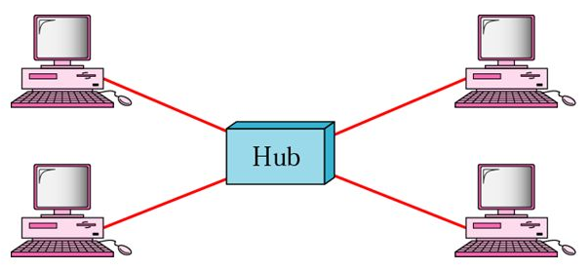
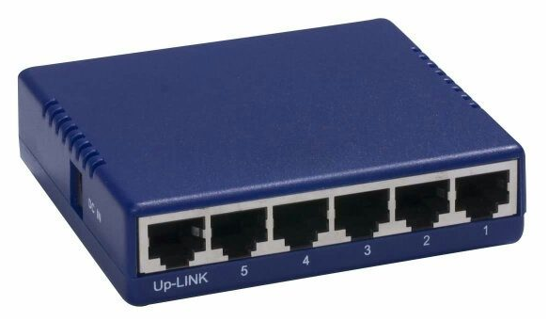
Introduction (Contd.)
Star Topology
In a star topology, each device has a dedicated point-to-point link only to a central controller, usually called a Hub
Properties
Does not allow direct data transfer between devices
The central controller acts as an exchange
Less expensive than mesh topology and it is easy to install and reconfigure
The topology is robust, if one link fails only that device/link is affected hence easy to identify faults and fault isolation
Since central controller controls the entire network, if it goes down the entire network is affected
Figure. Star Topology
Applications
Used in Local Area networks(LAN)

Slide 29
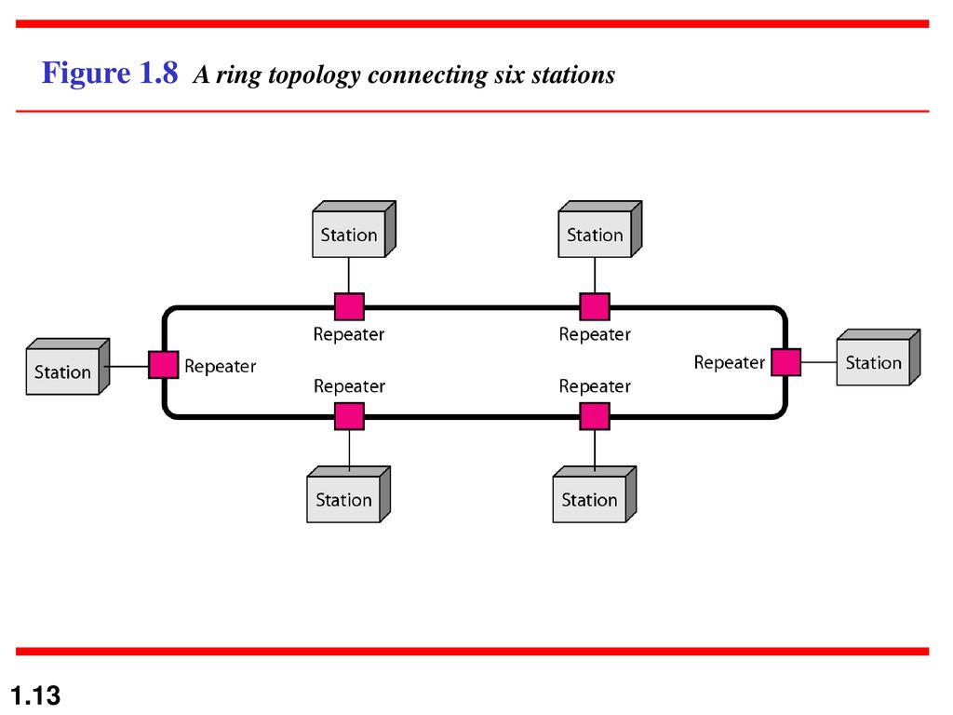
Introduction (Contd.)
Ring Topology
In a ring topology, each device has a dedicated point-to-point connection with only the two devices on either side of it
A signal is passed along the ring in one direction, from device to device, until it reaches its destination
Each device in the ring incorporates a repeater. When a device receives a signal intended for another device, its repeater regenerates the bits and passes them along
Properties
Relatively easy to install and reconfigure as each device is linked to only its immediate neighbors
Signal is circulating in a ring at all times, if one device does not receive a signal within a specified period, it can issue an alarm which alerts the network operator to the problem and its location
The breakage of the link may disable the entire network
Applications
In Local Area Networks – IBM Token ring
Figure. Ring Topology

Slide 30
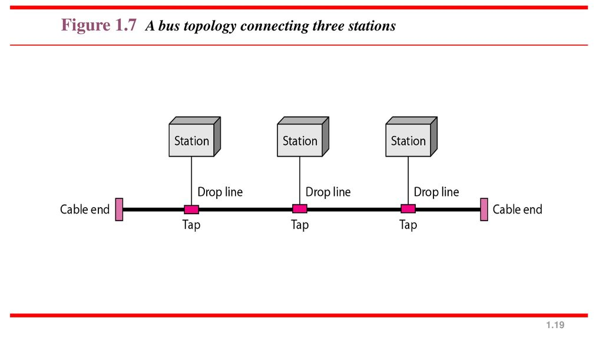
Introduction (Contd.)
Bus Topology
Provides a multipoint connection where one long cable acts as a backbone to link all the devices in a network
The nodes are connected to the bus cable by drop lines and taps.
A drop line is a connection running between the device and the main cable. A tap is a connector that either splices into the main cable or punctures the sheathing of a cable to create a contact with the metallic core
As a signal travels along the backbone, some of its energy is transformed into heat. Therefore, it becomes weaker and weaker as it travels farther and farther. For this reason there is a limit on the number of taps a bus can support and on the distance between those taps.
Figure. Bus Topology

Slide 31
Introduction (Contd.)
Bus Topology
Properties
Ease of installation- Backbone cable can be laid along the most efficient path, then connected to the nodes by drop lines of various lengths.
Installation cost is less as redundancy is eliminated.
Reconnection and fault isolation is difficult also signal reflection at the taps can degrade the quality of the signal.
A fault or break in the bus cable stops all transmission, even between devices on the same side of the problem. The damaged area reflects signals back in the direction of origin, creating noise in both directions.

Slide 32
Introduction (Contd.)
Network Types
Networks can be classified based on the geographical area they cover as Local Area Networks(LAN), Wide Area Networks(WAN) and Internet
Local Area Networks (LAN)
A LAN is usually privately owned and connects some hosts in a single office, building, or campus.
Depending on the needs of an organization, a LAN can be as simple as two PCs and a printer in someone’s home office, or it can extend throughout a company and include audio and video devices
Each host in a LAN has an identifier, an address, that uniquely defines the host in the LAN. A packet sent by a host to another host carries both the source host’s and the destination host’s addresses
The switch eases the traffic in the LAN and allows more than one pair to communicate with each other at the same time if there is no common source and destination among them

Slide 33
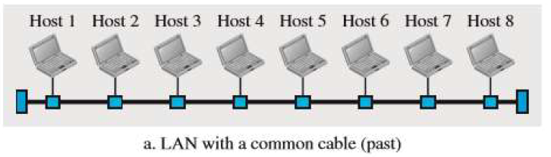
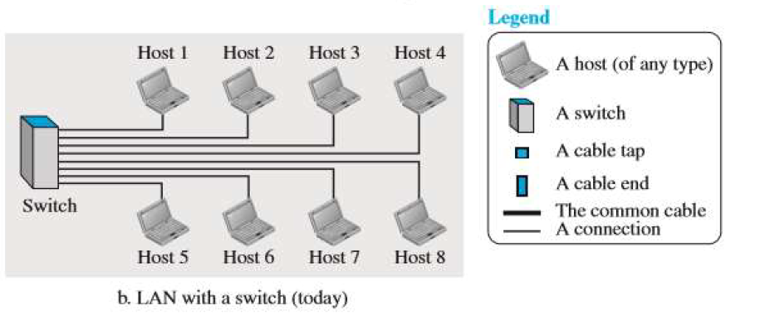
Introduction (Contd.)
Network Types

Slide 34
Introduction (Contd.)
Network Types
Wide Area Networks (WAN)
A wide area network (WAN) is also an interconnection of devices capable of communication. There are differences between LAN and a WAN
A LAN is normally limited in size, spanning an office, a building, or a campus; a WAN has a wider geographical span, spanning a town, a state, a country, or even the world
A LAN interconnects hosts; a WAN interconnects connecting devices such as switches, routers, or modems
A LAN is normally privately owned by the organization that uses it; a WAN is normally created and run by communication companies and leased by an organization that uses it
Types of WAN
Point to Point WAN: A point-to-point WAN is a network that connects two communicating devices through a transmission media (cable or air)

Slide 35
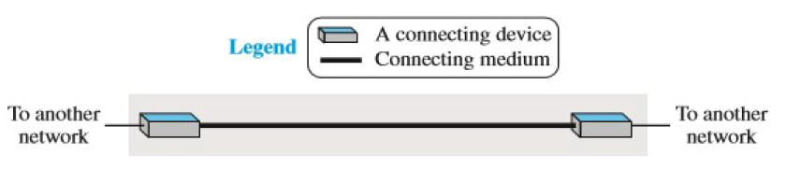
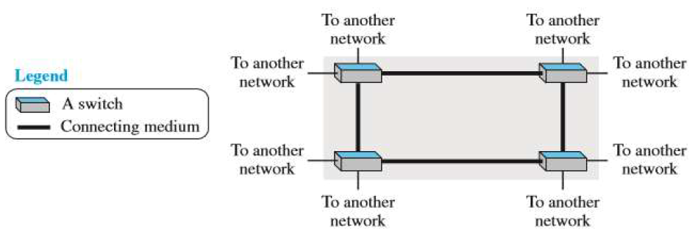
Introduction (Contd.)
Switched WAN: A switched WAN is a network with more than two ends. A switched WAN is used in the backbone of global communication today. It is a combination of several point-to-point WANs that are connected by switches

Slide 36
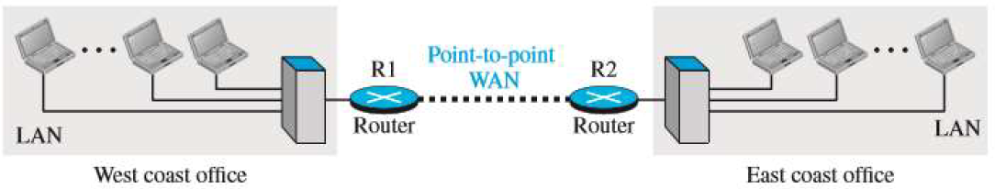
Introduction (Contd.)
Internetwork
The LANs and WANs are interconnected to form a internetwork also called as internet. The interconnection may be point to point or switched
Two networks are connected via a point to point WAN (this forms a private internet or internet) between two offices of an organization to make the communication possible.
An internet is a switched network in which a switch connects at least two links together. A switch needs to forward data from a network to another network when required
The two most common types of switched networks are Circuit-switched (Connection oriented) and Packet-switched networks (Connectionless)

Slide 37
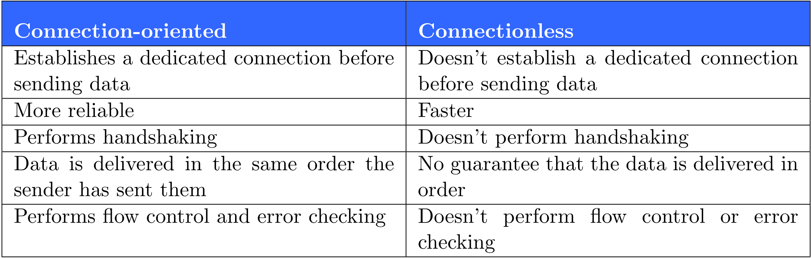
Introduction (Contd.)

Slide 38
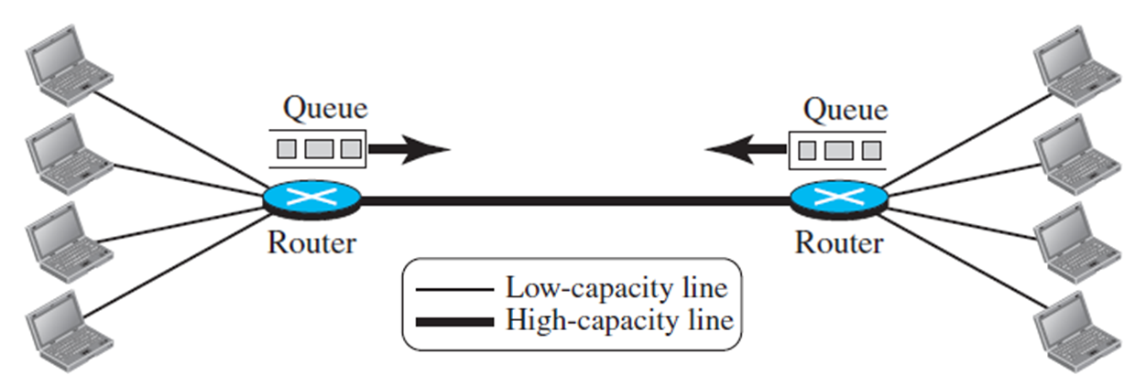
Introduction (Contd.)
Internetwork
In a computer network, the communication between the two ends is done in blocks of data called packets
The switches function for both storing and forwarding because a packet is an independent entity that can be stored and sent later
A router in a packet-switched network has a queue that can store and forward the packet, hence it is efficient than circuit switched network with some delay of packets

Slide 39
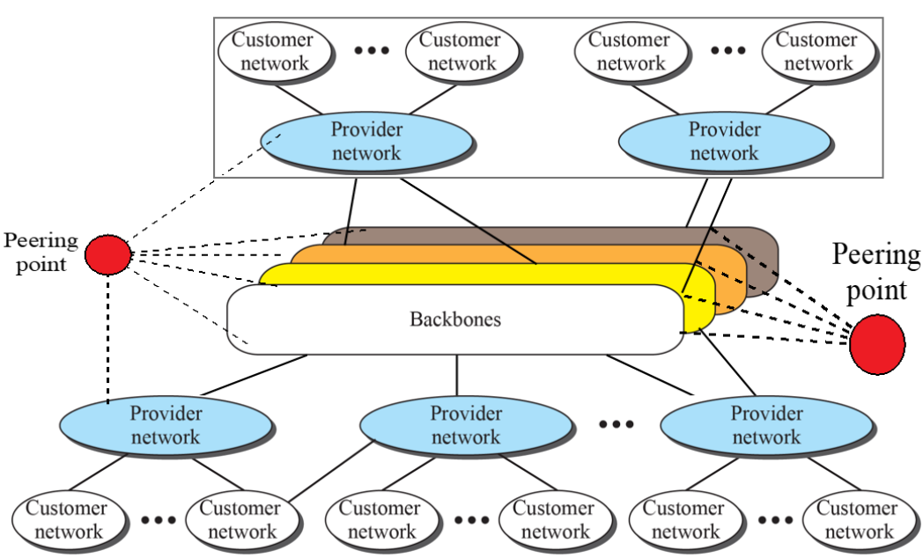
Introduction (Contd.)
The Figure shows the Internet as several backbones, provider networks, and customer networks.

Slide 40
Introduction (Contd.)
At the top level, the backbones are large networks owned by some communication companies such as Sprint, Verizon (MCI), AT&T, and NTT (BSNL, RAILTEL, Reliance, MNTL, etc.)
The backbone networks are connected through some complex switching systems, called Peering Points
The customer networks are networks at the edge of the Internet that actually use the services provided by the Internet. They pay fees to provider networks for receiving services.
At the second level, there are smaller networks, called provider networks, that use the services of the backbones for a fee. The provider networks are connected to backbones and sometimes to other provider networks
Backbones and provider networks are also called Internet Service Providers (ISPs).
The backbones are often referred to as international ISPs; the provider networks are often referred to as national or regional ISPs.

Slide 41
Introduction (Contd.)
Accessing the Network
To access any part of the internet the user has to become a part of it, this can happen using any of the following access methods
Using Telephone networks- Since the telephone system is connected to Internet, if the user owns the telephone service he can access the network using Digital Subscriber Line (DSL). DSL supports both data and voice communication
Using Cable Networks- More and more residents over the last two decades have begun using cable TV services instead of antennas to receive TV broadcasting. It provides a higher speed connection, but the speed varies depending on the number of neighbors that use the same cable
Using Wireless Networks - Wireless connectivity has recently become increasingly popular. A household or a small business can use a combination of wireless and wired connections to access the Internet. With the growing wireless WAN access, a household or a small business can be connected to the Internet through a wireless WAN.

Slide 42
Introduction (Contd.)
Accessing the Network
Direct connection to network- A large organization or a large corporation can itself become a local ISP and be connected to the Internet. This can be done if the organization or the corporation leases a high-speed WAN from a carrier provider and connects itself to a regional ISP. For example, a large university with several campuses can create an internetwork and then connect the internetwork to the Internet.

Slide 43
Introduction (Contd.)
Network Models/ Network Architecture
A networking model is also called as a networking architecture or a network blueprint
It refers to a comprehensive set of documents. Individually, each document describes one small function required for a network; collectively, these documents define everything that should happen for a computer network to work
Some documents define a protocol, which is a set of logical rules that devices must follow to communicate
Other documents define some physical requirements for networking. For example, a document could define the voltage and current levels used on a particular cable when transmitting data
Protocol is defined as set of rules that both sender and receiver and intermediate nodes need to follow to be able to communicate effectively
With simple communication only one protocol is sufficient, when communication is complex the task is divided between different layers and a protocol is required at every layer. This is called Protocol Layering

Slide 44
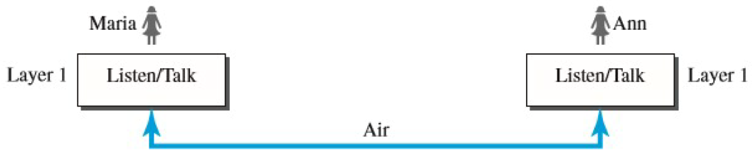
Introduction (Contd.)
Figure. Simple Communication
Assume Mr. X and Mr. Y are neighbors with a lot of common ideas. Communication between them takes place in one layer, face to face, in the same language
Set of rules needs to be followed are (Simple Communication: Creating, Sending/ Receive)
X and Y know that they should greet each other when they meet
They know that they should limit their vocabulary to the level of their friendship
Each party knows that she should catch phrase from speaking when the other party is speaking
Each party knows that the conversation should be a dialog, not a monolog: both should have the opportunity to talk about the issue
They should exchange some nice words when they leave

Slide 45
Introduction (Contd.)
Complex Communication (Creating, Encryption/ Decryption, Sending/ Receiving)
Mr. X and Mr. Y move to different places, and they decide to continue their conversation using regular mail through the post office. However, they do not want their ideas to be revealed by other people if the letters are intercepted
They agree on an encryption/decryption technique. The sender of the letter encrypts it to make it unreadable by an intruder; the receiver of the letter decrypts it to get the original letter
The communication between X and Y takes place in three layers. Let us assume that X sends the first letter to Y
X talks to the machine at the third layer as though the machine is Y and is listening to her. The third layer machine listens to what X says and creates the plaintext (a letter in English), which is passed to the second layer machine. The second layer machine takes the plaintext, encrypts it, and creates the ciphertext, which is passed to the first layer machine. The first layer machine, presumably a robot, takes the ciphertext, puts it in an envelope, adds the sender and receiver addresses, and mails it.

Slide 46
Introduction (Contd.)
Complex Communication
Protocol layering enables us to divide a complex task into several smaller and simpler tasks also we can separate the services from the implementation- A layer needs to be able to receive a set of services from the lower layer and to give the services to the upper layer; we don’t care about how the layer is implemented.

Slide 47
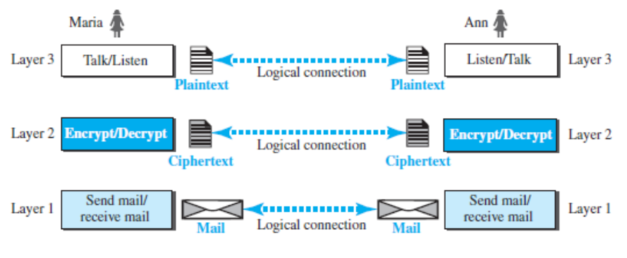
Introduction (Contd.)
Principles Protocol Layering
1st Principle
For a bidirectional communication each layer is required to perform opposite tasks, one in each direction
2nd Principle
The two objects under each layer at both sites should be identical.
Logical Connection
This means that there is a layer-to-layer communication. Mr. X and Mr. Y think that there is a logical (imaginary) connection at each layer through which they can send the object created from that layer.

Slide 48
Introduction (Contd.)
TCP/IP Protocol Suite
TCP/IP is a protocol suite (a set of protocols organized in different layers) used in the Internet today
It is a hierarchical protocol made up of interactive modules, each of which provides a specific functionality
The term hierarchical means that each upper level protocol is supported by the services provided by one or more lower level protocols
The original TCP/IP protocol suite was defined as four software layers built upon the hardware. Today, however, TCP/IP is thought of as a five-layer model

Slide 49
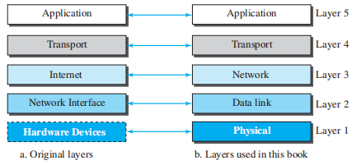
Introduction (Contd.)
Layers in TCP/IP model
The model has five layers- application, transport, network, datalink and physical layers. Figure below shows the original layers and the layers used in the book
Figure. Layers in TCP/IP Model

Slide 50
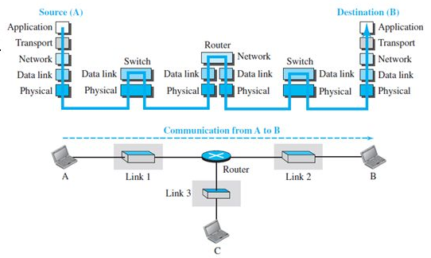
Introduction (Contd.)
Layers in TCP/IP Model
To understand the operation of the model, consider the communication between the devices A and B on the internet
There are five communicating devices in this communication: source host (computer A), the link-layer switch in link 1, the router, the link-layer switch in link 2, and the destination host (computer B)
Each device is involved with a set of layers depending on the role of the device in the internet

Slide 51
Introduction (Contd.)
Layers in TCP/IP Model
The two hosts are involved in all five layers; the source host needs to create a message in the application layer and send it down the layers so that it is physically sent to the destination host.
The destination host needs to receive the communication at the physical layer and then deliver it through the other layers to the application layer.
Note
The router is involved in only three layers, there is no transport or application layer in a router as long as the router is used only for routing
A link-layer switch in a link two layers has two layers data-link and physical

Slide 52
Introduction (Contd.)
Functionalities of layers in TCP/IP Suite
Physical Layer
This layer is the lowest layer in the model. It helps in the transmission of data between two machines that are communicating through a physical medium, which can be optical fibers, copper wire or wireless etc.
The following are the main functions of the physical layer:
Hardware Specification: The details of the physical cables, network interface cards, wireless radios, etc. are a part of this layer
Encoding and Signaling: How are the bits encoded in the medium is also decided by this layer. For example, on the copper wire medium, we can use different voltage levels for a certain time interval to represent ‘0’ and ‘1’. We may use +5mV for 1nsec to represent ‘1’ and -5mV for 1nsec to represent ‘0’. All the issues of modulation is dealt with in this layer. Eg, we may use Binary phase shift keying for the representation of ‘1’ and ‘0’ rather than using different voltage levels if we have to transfer in RF waves.

Slide 53
Introduction (Contd.)
Functionalities of layers in TCP/IP Suite
Physical Layer
Data Transmission and Reception: The transfer of each bit of data is the responsibility of this layer. This layer assures the transmission of each bit with a high probability. The transmission of the bits is not completely reliable as their is no error correction in this layer
Topology and Network Design: The network design is the integral part of the physical layer. Which part of the network is the router going to be placed, where the switches will be used, where we will put the hubs, how many machines is each switch going to handle, what server is going to be placed where, and many such concerns are to be taken care of by the physical layer. The various kinds of topologies that we decide to use may be ring, bus, star or a hybrid of these topologies depending on our requirements.

Slide 54
Introduction (Contd.)
Functionalities of layers in TCP/IP Suite
Data Link Layer
This layer provides reliable transmission of a packet by using the services of the physical layer which transmits bits over the medium in an unreliable fashion
This layer is concerned with :
Framing : Breaking input data into frames (typically a few hundred bytes) and caring about the frame boundaries and the size of each frame
Acknowledgment : Sent by the receiving end to inform the source that the frame was received without any error
Sequence Numbering : To acknowledge which frame was received
Error Detection : The frames may be damaged, lost or duplicated leading to errors. The error control is on link to link basis.
Retransmission : The packet is retransmitted if the source fails to receive acknowledgment
Flow Control : Necessary for a fast transmitter to keep pace with a slow receiver.

Slide 55
Introduction (Contd.)
Functionalities of layers in TCP/IP Suite
Network Layer
Its basic functions are routing and congestion control
Routing: This deals with determining how packets will be routed (transferred) from source to destination
Congestion Control
A router can be connected to 4-5 networks
If all the networks send packet at the same time with maximum rate possible then the router may not be able to handle all the packets and may drop some/all packets
In this context the dropping of the packets should be minimized and the source whose packet was dropped should be informed
Other issues related with this layer are transmitting time, delays, and jittering

Slide 56
Introduction (Contd.)
Functionalities of layers in TCP/IP Suite
Network Layer
Network Layer does not guarantee that the packet will reach its intended destination. There are no reliability guarantees.

Slide 57
Introduction (Contd.)
Functionalities of layers in TCP/IP Suite
Transport Layer
Its functions are :
Multiplexing / Demultiplexing : This layer multiplex several transport connections onto the same network connection (because creating and maintaining networks may be expensive). In the latter case, demultiplexing will be required at the receiving end. A point to note here is that communication is always carried out between two processes and not between two machines. This is also known as process-to-process communication
Fragmentation and Re-assembly : The data accepted by the transport layer from the session layer is split up into smaller units (fragmentation) if needed and then passed to the network layer. Correspondingly, the data provided by the network layer to the transport layer on the receiving side is re-assembled
Internetworking: Internetworks are multiple networks that are connected in such a way that they act as one large network, connecting multiple office or department networks. Internetworks are connected by networking hardware such as routers, switches, and bridges

Slide 58
Introduction (Contd.)
Functionalities of layers in TCP/IP Suite
Transport Layer
Types of service : The transport layer also decides the type of service that should be provided to the session layer. The service may be perfectly reliable or may be reliable within certain tolerances or may not be reliable at all. The message may or may not be received in the order in which it was sent. The decision regarding the type of service to be provided is taken at the time when the connection is stablished.
Error Control : If reliable service is provided then error detection and error recovery operations are also performed. It provides error control mechanism on end to end basis.
Flow Control : A fast host cannot keep pace with a slow one. Hence, this is a mechanism to regulate the flow of information.
Connection Establishment / Release : The transport layer also establishes and releases the connection across the network. This requires some sort of naming mechanism so that a process on one machine can indicate with whom it wants to communicate.

Slide 59
Introduction (Contd.)
Functionalities of Layers in TCP/IP Suite
Application Layer
The Fifth layer contains the application protocols with which the user gains access to the network.
The choice of which specific protocols and their associated functions are to be used at the application level is up to the individual user
Thus, the boundary between the presentation layer and the application layer represents a separation of the protocols imposed by the network designers from those being selected and implemented by the network users
For example, commonly used protocols are HTTP(for web browsing), FTP(for file transfer) etc.

Slide 60
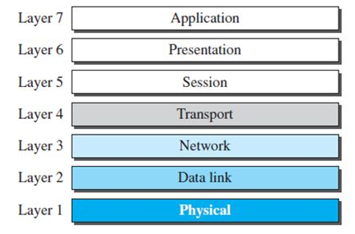
Introduction (Contd.)
The OSI Model
The Open System Interconnection (OSI) model is a layered framework for the design of network systems that allows communication between all types of computer systems.
It was first introduced in the late 1970s
It consists of seven separate but related layers, each of which defines a part of the process of moving information across a network

Slide 61
Introduction (Contd.)
The Open System Interconnection (OSI) Model
The International Organization for Standardization (ISO) is a multinational body dedicated to worldwide agreement on international standards.
An ISO standard that covers all aspects of network communications is the Open Systems Interconnection (OSI) model.
An open system is a set of protocols that allows any two different systems to communicate regardless of their underlying architecture.
The purpose of the OSI model is to show how to facilitate communication between different systems without requiring changes to the logic of the underlying hardware and software
The OSI model is not a protocol; it is a model for understanding and designing a network architecture that is flexible, robust, and interoperable. The OSI model was intended to be the basis for the creation of the protocols in the OSI stack

Slide 62
Introduction (Contd.)
Functionalities of layers in TCP/IP Suite
Session Layer
It deals with the Concept of Sessions i.e., when a user logins to a remote server he should be authenticated before getting access to the files and application programs
Another job of session layer is to establish and maintain sessions. If during the transfer of data between two machines the session breaks down, it is the session layer which re-establishes the connection
It also ensures that the data transfer starts from where it breaks keeping it transparent to the end user

Slide 63
Introduction (Contd.)
Functionalities of layers in TCP/IP Suite
Presentation Layer
This layer is concerned with the syntax and semantics of the information transmitted. In order to make it possible for computers with different data representations to communicate data structures to be exchanged can be defined in abstract way along with standard encoding.
It also manages these abstract data structures and allows higher level of data structures to be defined an exchange. It encodes the data in standard agreed way (network format).
Suppose there are two machines A and B one follows ‘Big Endian’ and other ‘Little Endian’ for data representation. This layer ensures that the data transmitted by one gets converted in the form compatible to other machine.

Slide 64
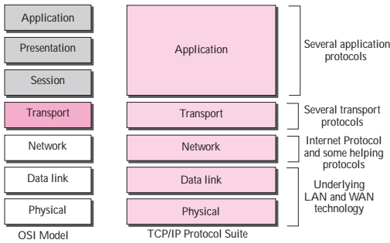
Introduction (Contd.)
OSI vs. TCP Model
When we compare the two models, we find that two layers, session and presentation, are missing from the TCP/IP protocol suite
These two layers were not added to the TCP/IP protocol suite after the publication of the OSI model.
The application layer in the suite is usually considered to be the combination of three layers in the OSI model.

Slide 65
Introduction (Contd.)
OSI vs. TCP Model
Lack of OSI models success:
The OSI model appeared after the TCP/IP protocol suite- OSI was completed when TCP/IP was fully in place and a lot of time and money had been spent on the suite; changing it would cost a lot
Some layers in the OSI model were never fully defined. For example, although the services provided by the presentation and the session layers were listed in the document, actual protocols for these two layers were not fully defined
Third, when OSI was implemented by an organization in a different application, it did not show a high enough level of performance when compared to TCP/IP

Slide 66
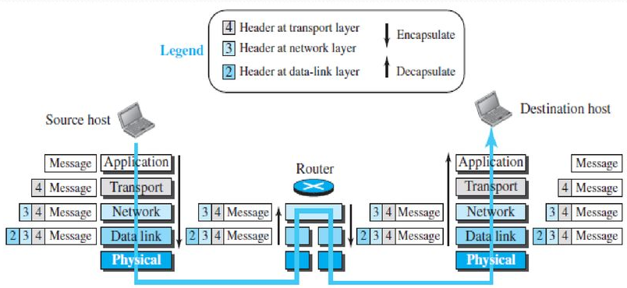
Introduction (Contd.)
Encapsulation and Decapsulation
One of the important concepts in protocol layering in the Internet is encapsulation/ decapsulation
Encapsulation adds information to a packet as it travels to its destination
Decapsulation reverses the process by removing the info, so a destination device can read the original data

Slide 67
Introduction (Contd.)
Encapsulation and Decapsulation
Encapsulation at the Source Host
At the application layer, the data to be exchanged is referred to as a message
A message normally does not contain any header or trailer, but if it does, we refer to the whole as the message
The message is passed to the transport layer. The transport layer takes the message as the payload, the load that the transport layer should take care of. It adds the transport layer header to the payload, which contains the identifiers of the source and destination application programs that want to communicate plus some more information that is needed for the end-to-end delivery of the message, such as information needed for flow, error control, or congestion control. The result is the transport-layer packet, which is called the segment (in TCP) and the user datagram (in UDP). The transport layer then passes the packet to the network layer.

Slide 68
Introduction (Contd.)
Encapsulation and Decapsulation
Encapsulation at the Source Host
The network layer takes the transport-layer packet as data or payload and adds its own header to the payload. The header contains the addresses of the source and destination hosts and some more information used for error checking of the header, fragmentation information, and so on. The result is the network-layer packet, called a datagram. The network layer then passes the packet to the data-link layer.
The data-link layer takes the network-layer packet as data or payload and adds its own header, which contains the link-layer addresses of the host or the next hop (the router). The result is the link-layer packet, which is called a frame. The frame is passed to the physical layer for transmission.
Decapsulation
1. After the set of bits are delivered to the data-link layer, this layer decapsulates the datagram from the frame and passes it to the network layer.

Slide 69
Introduction (Contd.)
Encapsulation and Decapsulation
The network layer only inspects the source and destination addresses in the datagram header and consults its forwarding table to find the next hop to which the datagram is to be delivered. The contents of the datagram should not be changed by the network layer in the router unless there is a need to fragment the datagram if it is too big to be passed through the next link. The datagram is then passed to the data-link layer of the next link.
The data-link layer of the next link encapsulates the datagram in a frame and passes it to the physical layer for transmission.
Decapsulation at the Destination Host, each layer only decapsulates the packet received, removes the payload, and delivers the payload to the next-higher layer protocol until the message reaches the application layer. It is necessary to say that decapsulation in the host involves error checking.

Slide 70
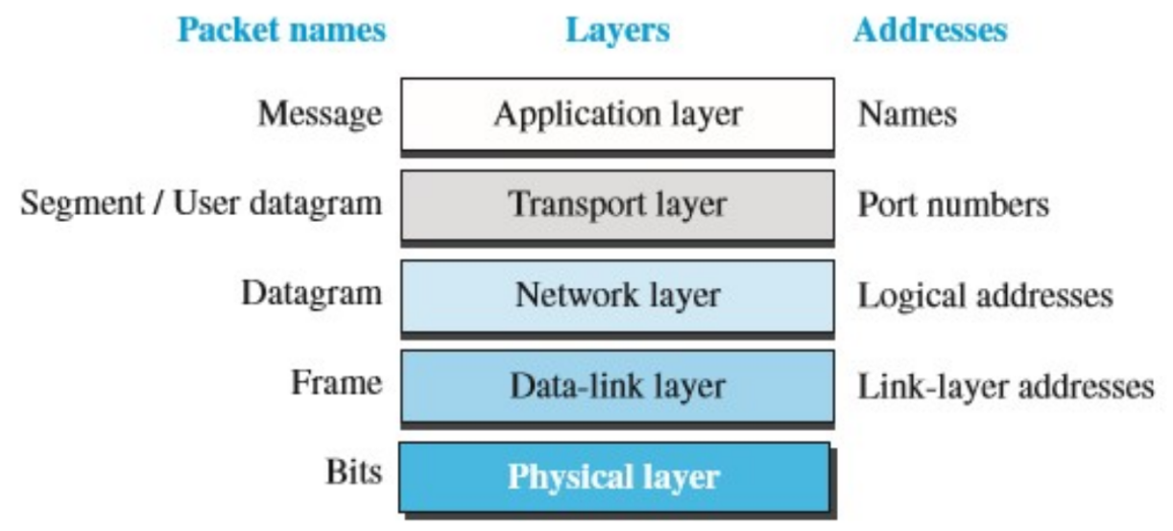
Introduction (Contd.)
Addressing
Any communication that involves two parties needs two addresses: source address and destination address
There is a relationship between the layer, the address used in that layer, and the packet name at that layer

Slide 71
Introduction (Contd.)
Addressing
Link layer/ Physical addresses: every interface (NIC) of a communicating device usually has a unique physical address, that helps in uniquely identifying and communicating with the interface at the physical and data link layers
These physical addresses are used in the data link layer frame headers, for carrying frames between neighboring nodes belonging to the same network. The address is written in hexadecimal format and it is of 6 bytes. For example: 0A:12:34:45:55:67
IP addresses used at the network layer (layer 3), to uniquely identify interfaces of communicating nodes globally. IP version 4 (IPV4) have 4 byte IP addresses in the form A.B.C.D and IP version 6 (IPV6) have 16 byte IP addresses.
Each communicating node on the Internet MUST have at least one unique public IP address, in order to successfully communicate on the Internet
An IP packet containing application layer data is carried end to end across the network, from the source node to a remote destination node, using mainly the destination IP address. Examples of IPV4 addresses are 10.0.0.1, 144.224.1.34 etc.

Slide 72
Introduction (Contd.)
Addressing
Port Addresses: Used at transport layer and used to identify various processes in the host machine. Theses are 16 bit numbers, written as decimal numbers.
Application addressing: Specific addresses or domain addresses. For example: www.rvce.edu.in, www.google.com

Slide 73
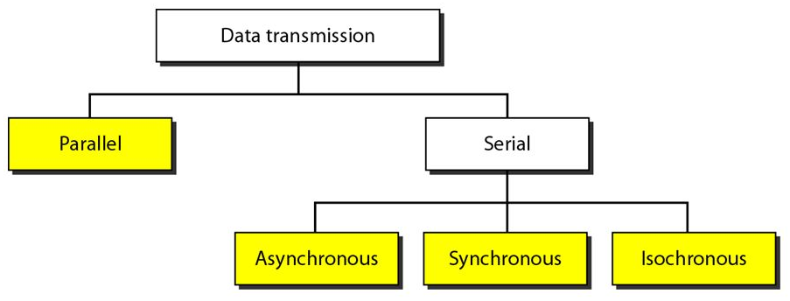
Introduction (Contd.)
Transmission Modes
The transmission of data from one device to another either serially or parallel
In parallel mode, multiple bits are sent with each clock tick
In serial mode, 1 bit is sent with each clock tick. While there is only one way to send parallel data, there are three subclasses of serial transmission: asynchronous, synchronous, and isochronous

Slide 74
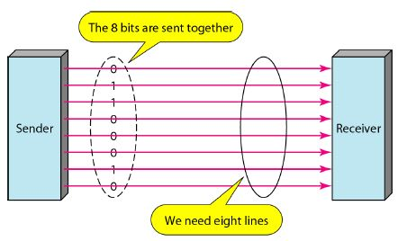
Introduction (Contd.)
Parallel Transmission
Binary data, consisting of 1s and 0s, may be organized into groups of n bits each, sending these n data bits at a time is called parallel transmission.
Uses n wires to send n bits at one time. That way each bit has its own wire, and all n bits of one group can be transmitted with each clock tick from one device to another.
Typically, the eight wires are bundled in a cable with a connector at each end.
Parallel transmission can increase the transfer speed by a factor of n over serial transmission.
Requires n communication lines (wires in the example) just to transmit the data stream.
Because of this it is expensive and limited to short distances.

Slide 75
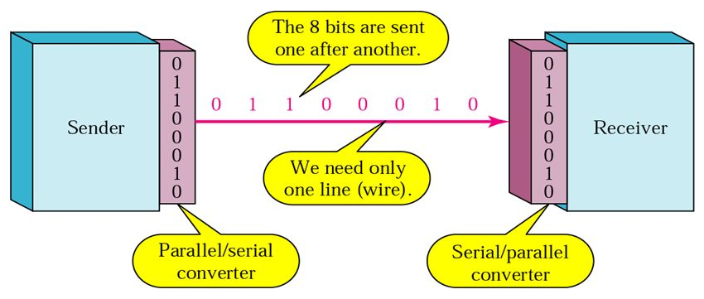
Introduction (Contd.)
Serial Transmission
In serial transmission one bit follows another, so we need only one communication channel rather than n to transmit data between two communicating devices
Reduces the cost of transmission over parallel by roughly a factor of n. Serial transmission occurs in one of three ways: asynchronous, synchronous, and isochronous.

Slide 76
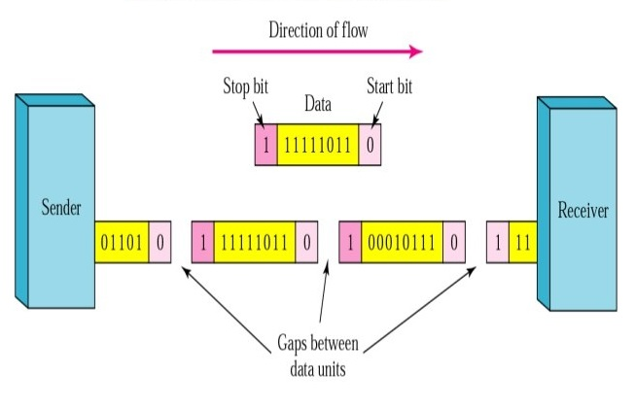
Introduction (Contd.)
Serial Transmission
Asynchronous Transmission
The timing of a signal is unimportant.
Information is received and translated by agreed upon patterns. As long as those patterns are followed, the receiving device can retrieve the information without regard to the rhythm in which it is sent.
The patterns are based on grouping the bit stream into bytes. Each group, usually 8 bits, is sent along the link as a unit
The sending system handles each group independently, relaying it to the link whenever ready, without regard to a timer.
Without synchronization, the receiver cannot use timing to predict when the next group will arrive
To alert the receiver to the arrival of a new group, therefore, an extra bit is added to the beginning of each byte.

Slide 77
Introduction (Contd.)
Serial Transmission
Asynchronous Transmission
This bit, usually a 0, is called the start bit. To let the receiver know that the byte is finished, 1 or more additional bits are appended to the end of the byte. These bits, usually 1s, are called stop bits.
By this method, each byte is increased in size to at least 10 bits, of which 8 bits is information and 2 bits or more are signals to the receiver.
In addition, the transmission of each byte may then be followed by a gap of varying duration. This gap can be represented either by an idle channel or by a stream of additional stop bits.
This mechanism is called asynchronous because, at the byte level, the sender and receiver do not have to be synchronized. But within each byte, the receiver must still be synchronized with the incoming bit stream.
When the receiver detects a start bit, it sets a timer and begins counting bits as they come in. After n bits, the receiver looks for a stop bit. As soon as it detects the stop bit, it waits until it detects the next start bit.
It is used in slow speed communication system.

Slide 78
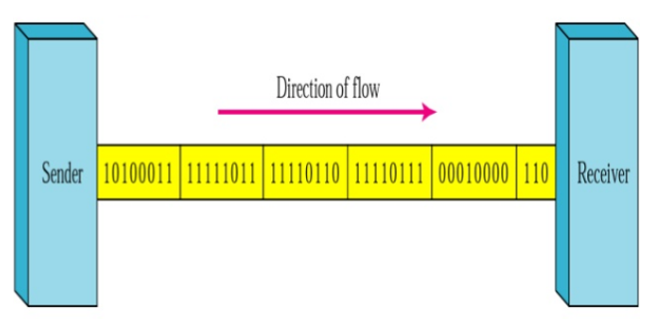
Introduction (Contd.)
Serial Transmission
Synchronous Transmission
In synchronous transmission, the bit stream is combined into longer “frames”, which may contain multiple bytes.
Each byte, however, is introduced onto the transmission link without a gap between it and the next one
If the sender wishes to send data in separate bursts, the gaps between bursts must be filled with a special sequence of 0s and 1s that means idle. The receiver counts the bits as they arrive and groups them in 8-bit units.
Without gaps and start and stop bits, there is no built-in mechanism to help the receiving device adjust its bit synchronization midstream
Timing becomes very important, therefore, because the accuracy of the received information is completely dependent on the ability of the receiving device to keep an accurate count of the bits as they come in.

Slide 79
Introduction (Contd.)
S. No. | Asynchronous Transmission | Synchronous Transmission
1 | In Asynchronous transmission, data is sent in form of bytes or characters. | In Synchronous transmission, data is sent in form of blocks or frames.
2 | Asynchronous transmission is slow. | Synchronous transmission is fast.
3 | In Asynchronous transmission, the time interval of transmission is not constant, it is random. | In Synchronous transmission, the time interval of transmission is constant.
4 | In Asynchronous transmission, there is a gap present between data. | In Synchronous transmission, there is no gap present between data.
5 | While in Asynchronous transmission, the transmission line remains empty during a gap in character transmission. | Efficient use of transmission lines is done in synchronous transmission.
6 | The start and stop bits are used in transmitting data that imposes extra overhead. | The start and stop bits are not used in transmitting data.
7 | High latency due to processing time and waiting for data to become available. | Low latency due to real-time communication.
8 | Examples: Email, File transfer, Online forms. | Examples: Telephonic conversations, Video conferencing, Online gaming.

Slide 80
Introduction (Contd.)
Serial Transmission
Isochronous
Isochronous transmission refers to a type of data transmission in which the data is sent at a fixed rate over a communication channel
In real-time audio and video uneven delays between frames are not acceptable. For example, TV images are broadcast at the rate of 30 images per second; they must be viewed at the same rate
If each image is sent by using one or more frames, there should be no delays between frames
For this type of application, synchronization between characters is not enough; the entire stream of bits must be synchronized.
The isochronous transmission guarantees that the data arrive at a fixed rate

Slide 81
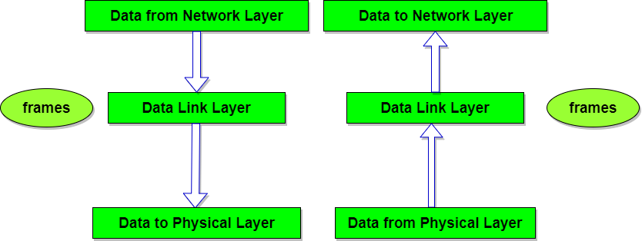
Data Link Layer
Data link layer performs the most reliable node to node delivery of data
It forms frames from the packets that are received from network layer and gives it to physical layer
Provides the services like Framing, Physical Addressing, Flow Control, Error Control, and Access Control
The data-link layer is divided into two sublayers
The upper sublayer of the Data-link Control (DLC) is also called as Logical Link Control (LLC)
The lower sublayer is called Media Access Control (MAC)
Sublayer | Services
DLC or LLC | Flow Control
MAC | Framing
MAC | Physical Addressing
MAC | Error Control
MAC | Access Control

Slide 82
Data Link Control (DLC)
DLC Services
The DLC deals with procedures for communication between two adjacent nodes-node-to-node communication—no matter whether the link is dedicated or broadcast
Data link control functions include framing and flow and error control
Framing
The data-link layer packs bits into frames, so that each frame is distinguishable from another
Framing in the data-link layer separates a message from one source to a destination by adding a sender address and a destination address
The destination address defines where the packet is to go; the sender address helps the recipient acknowledge the receipt
If whole message is packed in one frame it makes flow and error control very inefficient also when a message is carried in one very large frame, even a single-bit error would require the retransmission of the whole frame
However, if a message is divided into smaller frames, a single-bit error affects only that small frame

Slide 83
Data Link Control (DLC)
DLC services
Frame Size
Frames can be of fixed or variable size
In fixed-size framing, there is no need for defining the boundaries of the frames; the size itself can be used as a delimiter.
In variable-size framing it is necessary to define the end of one frame and the beginning of the next
There are two approaches
Character/ Byte Oriented
Bit oriented

Slide 84
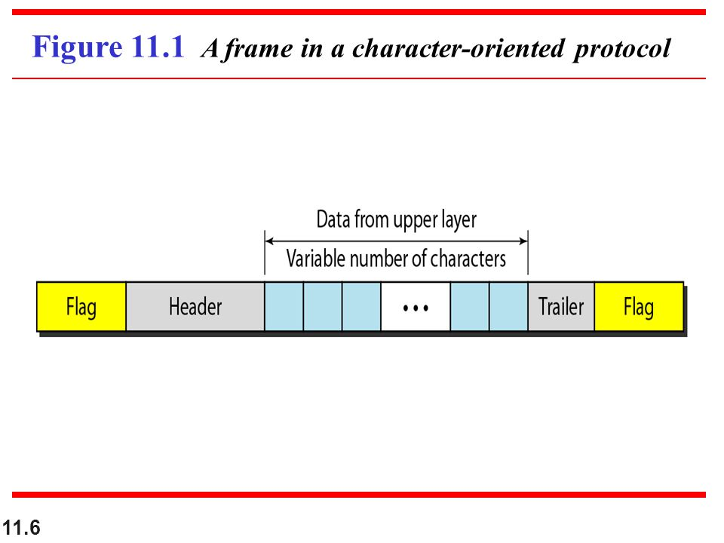
Data Link Control (DLC)
DLC services
Frame Size
Bit Oriented/ Bit Stuffing
The data to be carried are 8-bit characters
In the header, carries the source and destination addresses and other control information are multiple of 8 bits
Also, the trailer, carries the error detection redundant bits, are multiples of 8 bits.
To separate one frame from the next, an 8-bit (1-byte) flag is added at the beginning and the end of a frame.
The flag, composed of protocol-dependent special characters, signals the start or end of a frame.

Slide 85
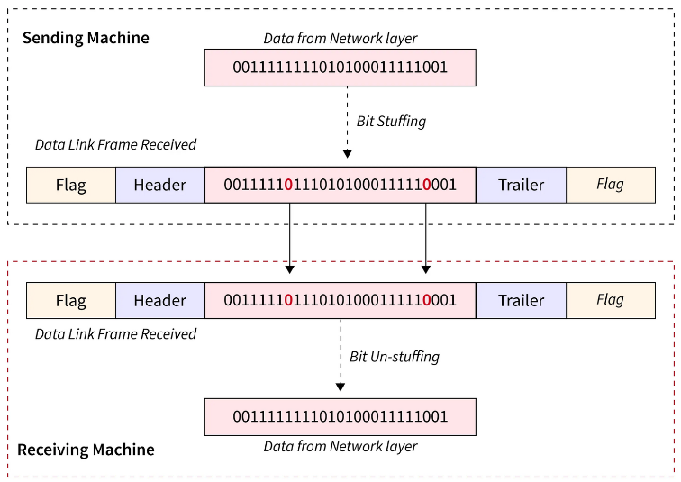
Data Link Control (DLC)

Slide 86
Data Link Control (DLC)
DLC services
Frame Size
Byte Stuffing
The flag used as delimiter is usually selected to be any character not used for text communication
However, with other types of data like graphics, audio, video, the flag may become part of data and receiver may think it to be end of the frame
To prevent this, byte stuffing technique is used- A special byte is added to the data section of the frame when there is a character with the same pattern as the flag
The data section is stuffed with an extra byte. This byte is usually called the escape character (ESC) and has a predefined bit pattern
Whenever the receiver encounters the ESC character, it removes it from the data section and treats the next character as data, not as a delimiting flag
If the escape character is part of the text, an extra one is added to show that the second one is part of the text

Slide 87
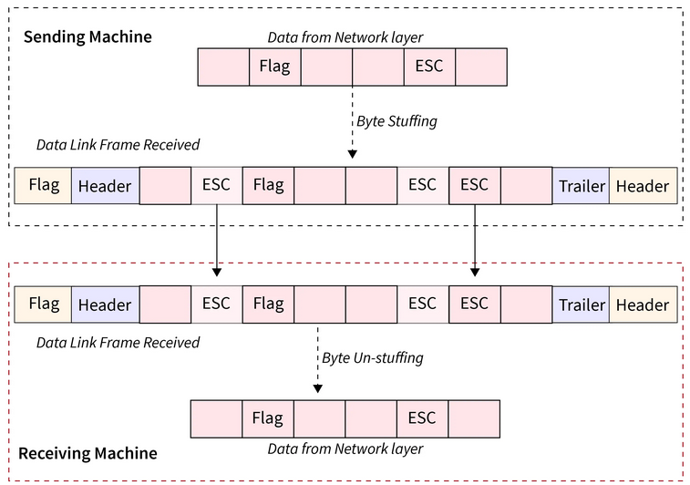
Data Link Control (DLC)

Slide 88
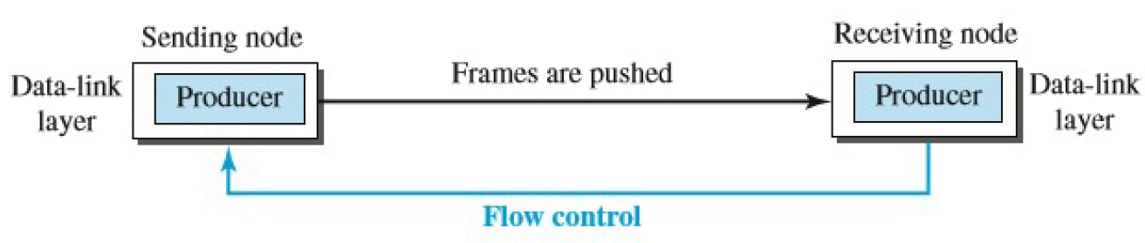
Data Link Control (DLC)
DLC services
Flow Control
Whenever an entity produces items and another entity consumes them, there should be a balance between production and consumption rates
If the items are produced faster than they can be consumed, the consumer can be overwhelmed and may need to discard some items
If the items are produced more slowly than they can be consumed, the consumer must wait, and the system becomes less efficient
Methods: Feedback and Use of Buffers

Slide 89
Data Link Control (Contd.)
DLC services
Flow Control
The data-link layer at the sending node tries to push frames toward the data-link layer at the receiving node.
If the receiving node cannot process and deliver the packet to its network layer at the same rate that the frames arrive, it becomes overwhelmed with frames
The Flow control in this case can be feedback from the receiving node to the sending node to stop or slow down pushing frames
Implementation using Buffers
A buffer is a set of memory locations that can hold packets at the sender and receiver
The flow control communication can occur by sending signals from the consumer to the producer
When the buffer of the receiving data-link layer is full, it informs the sending data-link layer to stop pushing frame

Slide 90
Data Link Control (Contd.)
DLC Services
Error Control
Since the underlying technology at the physical layer is not fully reliable, error control at the data-link layer to prevent the receiving node from delivering corrupted packets to its network layer
The error control at the data-link layer is implemented using one of the following two methods. In both methods, a CRC is added to the frame header by the sender and checked by the receiver.
If the frame is corrupted, it is silently discarded; if it is not corrupted, the packet is delivered to the network layer. This method is used mostly in wired LANs such as Ethernet.
If the frame is corrupted, it is silently discarded; if it is not corrupted, an acknowledgment is sent (for the purpose of both flow and error control) to the sender
The flow and error control can be combined-the acknowledgment that is sent for flow control can also be used for error control to tell the sender the packet has arrived uncorrupted
The lack of acknowledgment means that there is a problem in the sent frame

Slide 91
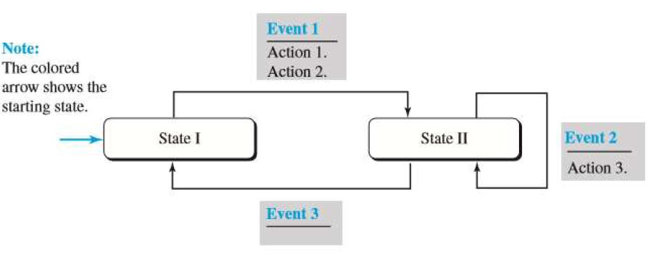
Data Link Layer Protocols (Contd.)
These protocols deal with flow and error control mechanisms. The behavior of the protocol can be demonstrated using the Finite State Machine(FSM).
An FSM has States, the machine is in one of the states until an Event occurs
On occurrences of an event some actions are taken and the machine moves to another/same state
One of the states must be defined as the initial state, the state in which the machine starts when it turns on

Slide 92
Data Link Layer Protocols (Contd.)
There are two flow and error control protocols
1. Simple Protocol- For ideal channel, hence no flow/ error control is required
2. Stop and Wait- For Noisy channel

Slide 93
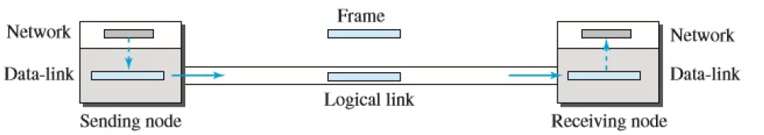
Data Link Layer Protocols (Contd.)
Simple Protocol
The sender site should not send a frame until its network layer has a message to send
The receiver site cannot deliver a message to its network layer until a frame arrives
Sender and receiver FSM has only one state, the ready state. The sending machine remains in the ready state until a request comes from the process in the network layer
When this event occurs, the sending machine encapsulates the message in a frame and sends it to the receiving machine
The receiving machine remains in the ready state until a frame arrives from the sending machine
When this event occurs, the receiving machine decapsulates the message out of the frame and delivers it to the process at the network layer

Slide 94
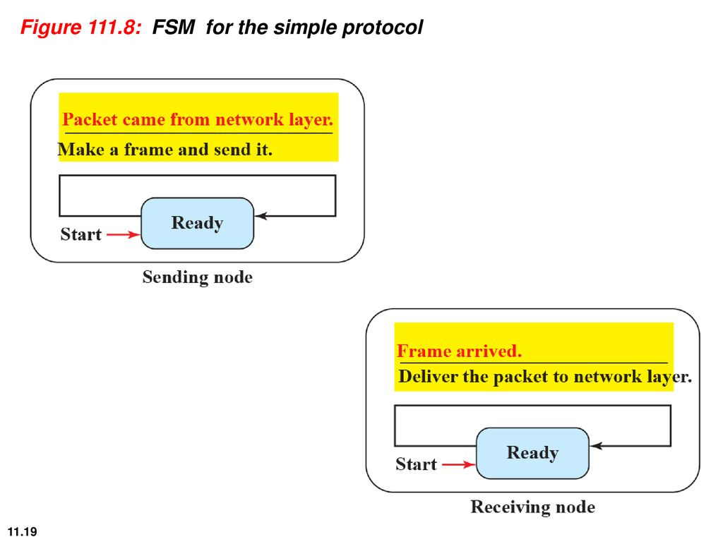
Data Link Layer Protocols (Contd.)
Simple Protocol
FSM and Flow Diagram

Slide 95
Data Link Layer Protocols (Contd.)
Stop and Wait Protocol
Uses both flow and error control. In this protocol, the sender sends one frame at a time and waits for an acknowledgment before sending the next one
CRC is added by the sender to every frame to detect the errors
When a frame arrives at the receiver site, it is checked. If its CRC is incorrect, the frame is corrupted and silently discarded
The silence of the receiver is a signal for the sender that a frame was either corrupted or lost
Every time the sender sends a frame, it starts a timer
If an acknowledgment arrives before the timer expires, the timer is stopped and the sender sends the next frame (if it has one to send)
If the timer expires, the sender resends the previous frame, assuming that the frame was either lost or corrupted. This means that the sender needs to keep a copy of the frame until its acknowledgment arrives
When the corresponding acknowledgment arrives, the sender discards the copy and sends the next frame if it is ready

Slide 96
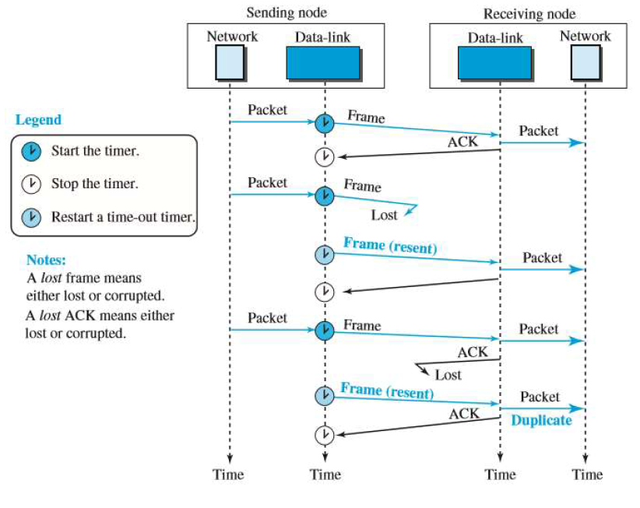
Data Link Layer Protocols (Contd.)
Stop and Wait Protocol
Flow Diagram

Slide 97
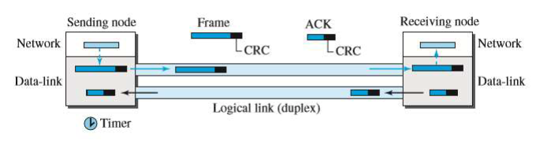
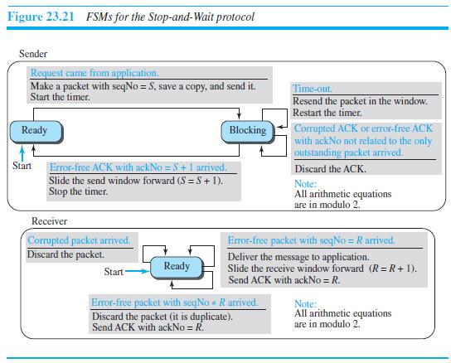
Data Link Layer Protocols (Contd.)
Stop and Wait Protocol
FSM for sender and receiver in Stop and Wait Protocol

Slide 98
Data Link Layer Protocols (Contd.)
Stop and Wait Protocol
FSM for sender and receiver in Stop and Wait Protocol
Sender States: Initially, the sender is in the ready state, but it can move between the ready and blocking state
Ready State
When the sender is in this state, it is only waiting for a packet from the network layer.
If a packet comes from the network layer, the sender creates a frame, saves a copy of the frame, starts the only timer and sends the frame
Then the sender then moves to the blocking state

Slide 99
Data Link Layer Protocols (Contd.)
Stop and Wait Protocol
FSM for sender and receiver in Stop and Wait Protocol
Blocking State: When the sender is in this state, three events can occur:
If a time-out occurs, the sender resends the saved copy of the frame and restarts the timer.
If a corrupted ACK arrives, it is discarded.
If an error-free ACK arrives, the sender stops the timer and discards the saved copy of the frame. It then moves to the ready state
Receiver : The receiver is always in the ready state. Two events may occur:
If an error-free frame arrives, the message in the frame is delivered to the network layer and an ACK is sent.
If a corrupted frame arrives, the frame is discarded.

Slide 100
Data Link Layer Protocols (Contd.)
Stop and Wait Protocol
Flow Diagram
The problem in the above diagram is that there are duplicate frames. To handle this problem sequence numbers and acknowledgement numbers are added to the frames transmitted. Sequence numbers are 0, 1, 0, 1, 0, 1, . . . ; the acknowledgment numbers can also be 1, 0, 1, 0, 1, 0, … In other words, the sequence numbers start with 0, the acknowledgment numbers start with 1. An acknowledgment number always defines the sequence number of the next frame to receive.
Piggybacking
In bidirectional communication a data and to make the communication more efficient, the data in one direction is piggybacked with the acknowledgment in the other direction. When node A is sending data to node B, Node A also acknowledges the data received from node B. This is called piggybacking.

Slide 101
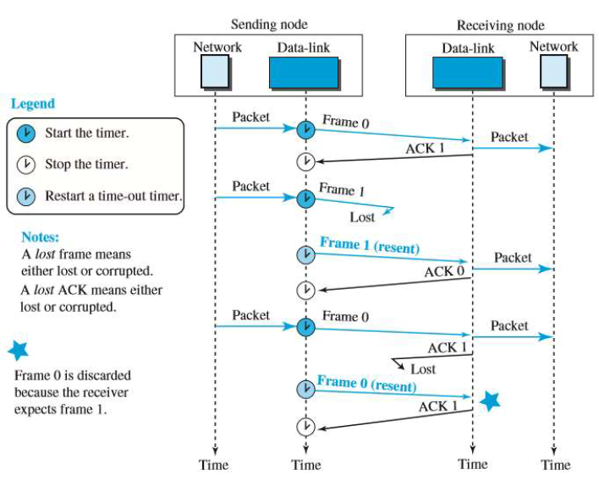
Data Link Layer Protocols (Contd.)
Stop and Wait Protocol
Flow Diagram
Figure. Flow Diagram with Seq. No and ACK

Slide 102
Data Link Layer Protocols (Contd.)
High-level Data Link Control (HDLC)
High-level Data Link Control (HDLC) is a bit-oriented protocol for communication over point-to-point and multipoint links
It implements the Stop-and-Wait protocol
Transfer Modes
HDLC provides two common transfer modes that can be used in different configurations: Normal Response Mode (NRM) and Asynchronous Balanced Mode (ABM)
In Normal Response Mode (NRM), the station configuration is unbalanced. There is one primary station and multiple secondary stations. A primary station can send commands; a secondary station can only respond. The NRM is used for both point-to-point and multipoint links
In ABM, the configuration is balanced. The link is point-to-point, and each station can function as a primary and a secondary (acting as peers).

Slide 103
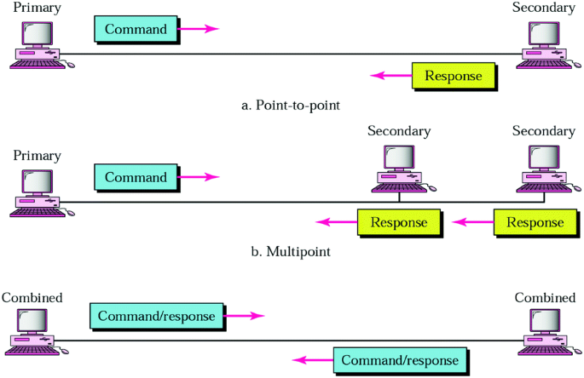
Data Link Layer Protocols (Contd.)
Figure. Normal Response Mode (NRM)
Figure. Asynchronous Balanced Mode (ABM)

Slide 104
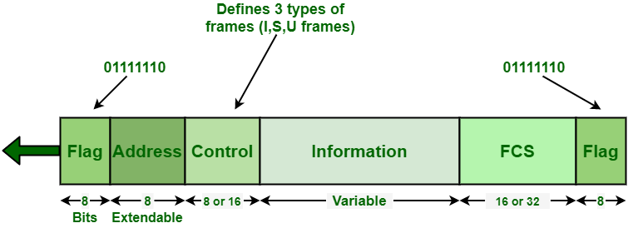
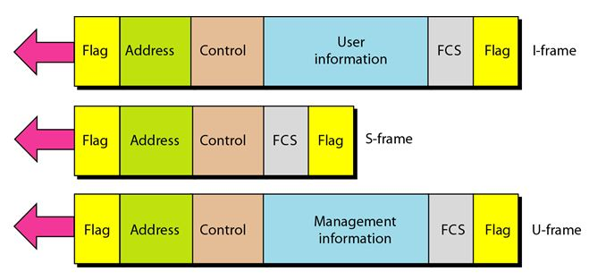
Data Link Layer Protocols (Contd.)
Flag: It is an 8-bit sequence with a bit pattern 01111110 that basically helps in identifying both starting and end of a frame. This bit pattern also serves as a synchronization pattern for receiver. This bit pattern is also not allowed to occur anywhere else inside a complete frame
Address: The address field generally includes HDLC address of secondary station. It helps to identify secondary station will sent or receive data frame. This field also generally consists of 8 bits therefore it is capable of addressing 256 addresses
Control: This is the third field of the HDLC frame and it is a 1 or 2-byte segment of the frame and is mainly used for flow control and error control. I-Frame is used when 1st bit is ‘0’, S-Frame is used when 1st two bits are ‘ 10‘, and U-Frame is used when 1st two bits are ‘11’.

Slide 105
Data Link Layer Protocols (Contd.)
HDLC Framing
HDLC defines three types of frames: Information frames (I-frames), Supervisory frames (S-frames), and Unnumbered frames (U-frames)
Each type of frame serves as an envelope for the transmission of a different type of message.
Iframes are used to data-link user data and control information relating to user data (piggybacking)
S-frames are used only to transport control information
U-frames are reserved for system management. Information carried by U-frames is intended for managing the link itself
Each frame in HDLC contain up to six fields.- a beginning flag field, an address field, a control field, an information field, a frame check sequence (FCS) field, and an ending flag field

Slide 106
Data Link Layer Protocols (Contd.)
Information Field: The information field contains the user’s data from the network layer. Its length can vary from one network to another.
FCS Field: The frame check sequence (FCS) is the HDLC error detection field. It can contain either a 2- or 4-byte CRC.

Slide 107
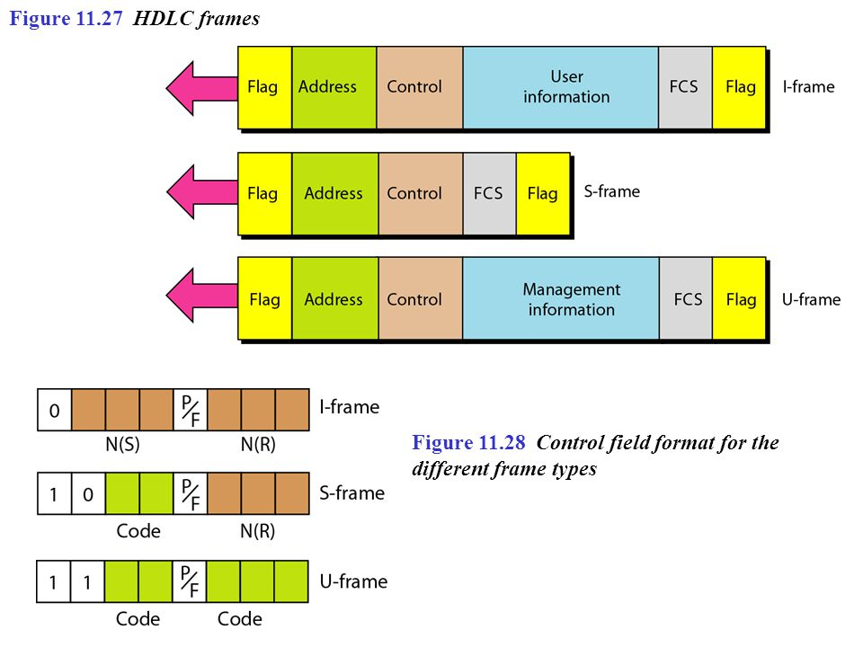
Data Link Layer Protocols (Contd.)
Control information for various frames
I-frame- Used along with piggybacking
Identifying bit value -0
N(S)- Sequence Number.
N(R)- Acknowledgement Number.
The P/F field is a single bit with a dual purpose. It has meaning only when it is set (bit = 1) and can mean poll or final
It means poll when the frame is sent by a primary station to a secondary (when the address field contains the address of the receiver).
It means final when the frame is sent by a secondary to a primary (when the address field contains the address of the sender).

Slide 108
Data Link Layer Protocols (Contd.)
Control information for various frames
S-Frame
Supervisory frames are used for flow and error control whenever piggybacking is either impossible or inappropriate.
Identifying bit value -10
The last 3 bits, called N(R), correspond to the acknowledgment number (ACK) or negative acknowledgment number (NAK), depending on the type of S-frame.
Code- 2 bits
00- Receive Ready- This kind of frame acknowledges the receipt of a safe frame or group of frames.
10- Receive Not Ready- It acknowledges the receipt of a frame or group of frames, and it announces that the receiver is busy and cannot receive more frames. It acts as a kind of congestion-control mechanism by asking the sender to slow down.
01- Reject- This is a NAK frame- Go back N
11- Selective Reject- This is also a NAK frame.- Selective reject.

Slide 109
Data Link Layer Protocols (Contd.)
Control information for various frames
U Frame
Unnumbered frames are used to exchange session management and control information between connected devices
U-frame codes are divided into two sections: a 2-bit prefix before the P/ F bit and a 3-bit suffix after the P/F bit
Together, these two segments (5 bits) can be used to create up to 32 different types of U-frames

Slide 110
Data Link Layer Protocols (Contd.)
Point-to-Point Protocol
One of the most common protocols for point-to-point access. Services Provided by point to point protocol
PPP does not provide flow control.
A sender can send several frames one after another with no concern about overwhelming the receiver.
PPP has a very simple mechanism for error control. A CRC field is used to detect errors. If the frame is corrupted, it is silently discarded; the upper-layer protocol needs to take care of the problem.
Lack of flow control and sequence numbering may cause a packet to be received out of order
PPP does not provide a. sophisticated addressing mechanism to handle frames in a multipoint configuration

Slide 111
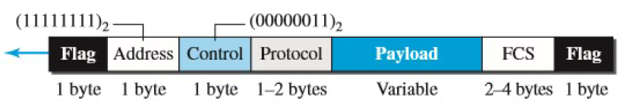
Data Link Layer Protocols (Contd.)
Framing
Flag: A PPP frame starts and ends with a 1-byte flag with the bit pattern 01111110.
Address: The address field in this protocol is a constant value and set to 11111111 (broadcast address).
Control: This field is set to the constant value 00000011 (imitating unnumbered frames in HDLC). PPP does not provide any flow control. Error control is also limited to error detection.
Protocol: The protocol field defines what is being carried in the data field: either user data or other information. This field is by default 2 bytes long, but the two parties can agree to use only 1 byte.

Slide 112
Data Link Layer Protocols (Contd.)
Payload field: This field carries the user data. The data field is a sequence of bytes with the default of a maximum of 1500 bytes; but this can be changed during negotiation. The data field is byte-stuffed if the flag byte pattern appears in this field. Because there is no field defining the size of the data field, padding is needed if the size is less than the maximum default value or the maximum negotiated value.
FCS. The frame check sequence (FCS) is simply a 2-byte or 4-byte standard CRC.
Byte Stuffing
The escape character used when the flag appears in data in PPP is- 01111101
Transition Phases
A PPP connection goes through phases which can be shown in a transition phase diagram

Slide 113

Data Link Layer Protocols (Contd.)
Starts with the dead state. In this state, there is no active carrier (at the physical layer) and the line is quiet
When one of the two nodes starts the communication, the connection goes into the establish state. In this state, options are negotiated between the two parties.

Slide 114
Data Link Layer Protocols (Contd.)
If the two parties agree that they need authentication (for example, if they do not know each other), then the system needs to do authentication (an extra step); otherwise, the parties can simply start communication.
The link-control protocol packets are used for this purpose. Several packets may be exchanged here
Data transfer takes place in the open state. When a connection reaches this state, the exchange of data packets can be started.
The connection remains in this state until one of the endpoints wants to terminate the connection. In this case, the system goes to the terminate state.
The system remains in this state until the carrier (physical-layer signal) is dropped, which moves the system to the dead state again.

Slide 115
Media Access Control
When nodes or stations are connected and use a common link, called a multipoint or broadcast link, There is a need for multiple-access protocol to coordinate access to the link.
One of the category of the protocol is Random Access Control Protocol- Designed to minimize the collisions. They are:
CSMA (Carrier Sense Multiple Access): It requires that each station first listen to the medium (or check the state of the medium) before sending. CSMA can reduce the possibility of collision, but it cannot eliminate it
CSMA/CD (CSMA with Collision Detection (CD)): a station monitors the medium after it sends a frame to see if the transmission was successful. If so, the station is finished. If there is a collision, the frame is sent again
CSMA/CA (CSMA with Collision Avoidance(CA)): The basic idea behind CSMA/CA is that the station should be able to receive while transmitting to detect a collision from different stations

Slide 116

Media Access Control (Contd.)
CSMA
The stations are connected to a shared channel (usually a dedicated medium)
The possibility of collision still exists because of propagation delay; when a station sends a frame, it still takes time (although very short) for the first bit to reach every station and for every station to sense it
A station may sense the medium and find it idle, only because the first bit sent by another station has not yet been received
Vulnerable time- Vulnerable time is the time during which no transmission should be done to avoid any collision, for CSMA it is equal to the propagation time Tp

Slide 117

Media Access Control (Contd.)
CSMA
When a station sends a frame and any other station tries to send a frame during this time, a collision will result
But if the first bit of the frame reaches the end of the medium, every station will already have heard the bit and will refrain from sending
Persistence Methods What should a station do if the channel is busy? What should a station do if the channel is idle?
Three methods have been devised to answer these questions: the 1-persistent method, the nonpersistent method, and the p-persistent method

Slide 118
Media Access Control (Contd.)
1-Persistent: The 1-persistent method is simple and straightforward. In this method, after the station finds the line idle, it sends its frame immediately (with probability 1). This method has the highest chance of collision because two or more stations may find the line idle and send their frames immediately
Nonpersistent: In the nonpersistent method, a station that has a frame to send senses the line. If the line is idle, it sends immediately. If the line is not idle, it waits a random amount of time and then senses the line again. The nonpersistent approach reduces the chance of collision because it is unlikely that two or more stations will wait the same amount of time and retry to send simultaneously. But this method reduces the efficiency of the network because the medium remains idle when there may be stations with frames to send.

Slide 119
Media Access Control (Contd.)
p-Persistent: This method is used if the channel has time slots with a slot duration equal to or greater than the maximum propagation time. The p-persistent approach combines the advantages of the other two strategies.

Slide 120
Media Access Control (Contd.)
CSMA/CD: In this method, a station monitors the medium after it sends a frame to see if the transmission was successful. If so, the station is finished. If, however, there is a collision, the frame is sent again
Consider the first bits transmitted by the two stations A and C. Each station continues to send bits in the frame until it detects the collision, once detecting a collision or getting a jamming signal, the station aborts its transmission

Slide 121
Media Access Control (Contd.)
Minimum Frame Size
For CSMA/CD to work, we need a restriction on the frame size. Before sending the last bit of the frame, the sending station must detect a collision, if any, and abort the transmission. This is so because the station, once the entire frame is sent, does not keep a copy of the frame and does not monitor the line for collision detection. Therefore, the frame transmission time Tfr must be at least two times the maximum propagation time Tp.
If the two stations involved in a collision are the maximum distance apart, the signal from the first takes time Tp to reach the second, and the effect of the collision takes another time TP to reach the first. So, the requirement is that the first station must still be transmitting after 2Tp.

Slide 122

Media Access Control (Contd.)
Figure. Flow Diagram for CSMA/CD

Slide 123
Media Access Control (Contd.)
Minimum Frame Size
Example
A network using CSMA/CD has a bandwidth of 10 Mbps. If the maximum propagation time (including the delays in the devices and ignoring the time needed to send a jamming signal, as we see later) is 25.6 μs, what is the minimum size of the frame?
Solution
The minimum frame transmission time is Tfr = 2 × Tp = 51.2 μs. This means, in the worst case, a station needs to transmit for a period of 51.2 μs to detect the collision. The minimum size of the frame is 10 Mbps × 51.2 μs = 512 bits or 64 bytes.

Slide 124
Media Access Control (Contd.)
CSMA/CA
Carrier sense multiple access with collision avoidance (CSMA/CA) was invented for wireless networks. Collisions are avoided through the use of CSMA/CA’s three strategies: the interframe space, the contention window, and acknowledgments.
Interframe Space (IFS): First, collisions are avoided by deferring transmission even if the channel is found idle. When an idle channel is found, the station does not send immediately. It waits for a period called the interframe space or IFS. After waiting an IFS time, if the channel is still idle, the station can send, but it still needs to wait a time equal to the contention window.
Contention Window(CW): If the participating node determines that the channel is free, they wait a random amount of time before sending after IFS. This duration corresponds to contention window. This time window doubles with each collision and corresponds to the binary exponential backoff (BEB) that is familiar from CSMA/CD.
Acknowledgment: With all these precautions, there still may be a collision resulting in destroyed data. In addition, the data may be corrupted during the transmission. The positive acknowledgment and the time-out timer can help guarantee that the receiver has received the frame.

Slide 125

Media Access Control (Contd.)
CSMA/CA
Frame exchange of data and control frames in time.
Before sending a frame, the source station senses the medium by checking the energy level at the carrier frequency.
The channel uses a persistence strategy with backoff until the channel is idle.
After the station is found to be idle, the station waits for a period called the Distributed Interframe Space (DIFS); then the station sends a control frame called the request to send (RTS).

Slide 126
Media Access Control (Contd.)
CSMA/CA
After receiving the RTS and waiting a period of time called the short interframe space (SIFS), the destination station sends a control frame, called the clear to send (CTS), to the source station.
This control frame indicates that the destination station is ready to receive data.
The source station sends data after waiting an amount of time equal to SIFS (Short IFS).
The destination station, after waiting an amount of time equal to SIFS, sends an acknowledgment to show that the frame has been received.

Slide 127

Media Access Control (Contd.)
CSMA/CA
Network Allocation Vector (NAV) shows how much time must pass before these stations are allowed to check the channel for idleness. Each time a station accesses the system and sends an RTS frame, other stations start their NAV. In other words, each station, before sensing the physical medium to see if it is idle, first checks its NAV to see if it has expired.

Slide 128


